Slide 1
Architecture model
PLA.sin := TPLA.sin; PLA.cos := TPLA.cos
PLA.sin := TPLA.sin; PLA.cos := TPLA.cos
ct4
ct3
Task
receiveBIT(PLA.sin, PLA.cos)
receiveMean(PLA.sin,
PLA.cos)
sendRes
sendMean
sendBIT
c2
Diagnosis P1
Diagnosis P2
Diagnosis P3
Diagnosis Decider
Diagnosis Decider
c1
Diagnosis P1
Diagnosis P2
t1
p1
sendBIT(PLA.Signal)
sendMean(PLA.CLB)
receiveMean
receiveBIT
produce(PLA.sin, PLA.cos)
ct2
BIT Diagnosis
ct1
Calibration Conversion
Extremum/Slope Diagnosis
Sensor Data
Data Processing Unit
Notes:
As a representation of the environment, compound component “sensor data” provides the input periodically. The component “Task” generates the four inputs, while the component “Cyclic trigger” gives the ‘start’ signal to send the inputs to data processing unit.
The compound automaton BIT Diagnosis receives two signal “PLA.sin” and “PLA.cos” and gives a valid/invalid signal of its input.
The component automaton Mean Data Calculation is used to convert the collected physical quantity to its original value.
The compound automaton Extremum/Slope Diagnosis integrates the signals and gives an overall judgment whether the input signal of system is valid or not.
//The component automaton Compensation & Filtering is used to give a standard output of collected data

Slide 2
Atom and Connector and Compound
Atom
ESCompund
Atom
Atom
Atom
Atom
Atom
Atom
Atom
Atom
BITCompound
BIT Diagnosis
Calibration Conversion
Extremum/Slope Diagnosis
Sensor Data
Data Processing Unit

Slide 3
Atom type
ct4
Signal Processing Unit
ct3
t1
p1
c2
BITAtom_enc
BITAtom_sin
BITAtom_cos
ESAtom_Decider
c1
BITAtom_Decider
ExtAtom
SloAtom
ct1
ct2
Task Unit

Slide 4
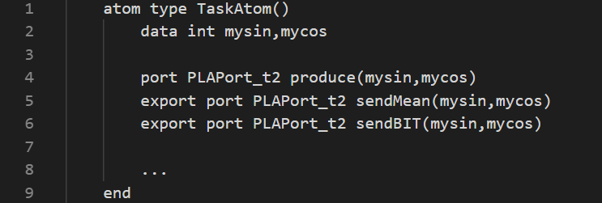
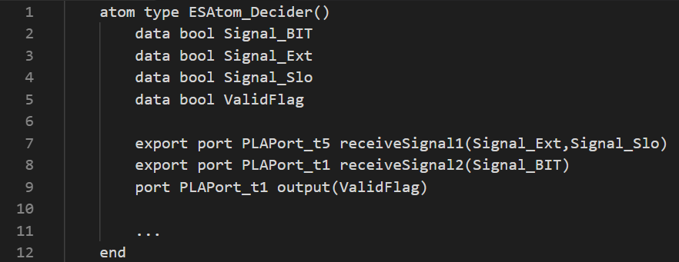
Port type
ct4
ct3
Task
sendMean
sendBIT
Type name | Parameters
PLAPort_t1 | bool
PLAPort_t2 | int, int
PLAPort_t3 | bool, bool, bool
PLAPort_t4 | int
PLAPort_t5 | bool, bool
t1
PLAPort_t2
PLAPort_t2
!Not export
PLAPort_t1
produce(PLA.sin, PLA.cos)
Task
sendMean
sendBIT
Extremum/Slope Decider
output
Sensor Data
produce(PLA.sin, PLA.cos)
receiveSignal1
receiveSignal2
c2
sendRes
PLAPort_t2
!Not export
PLAPort_t5
PLAPort_t1
Diagnosis Decider
Diagnosis P1
Diagnosis P2
receiveMean
receiveBIT

Slide 5
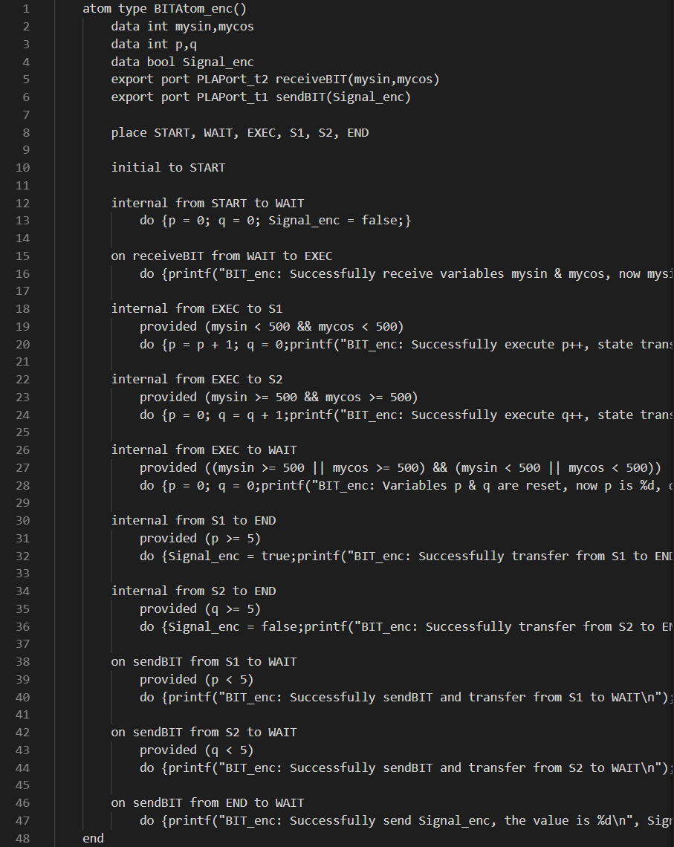
Atom Example —— BIT Diagnosis P1
START
receiveBIT(PLA.sin, PLA.cos)
Diagnosis P1
Diagnosis P2
Diagnosis P3
Diagnosis Decider
p:=0; q:=0
output
BIT Diagnosis
WAIT
sendBIT(PLA.Signal_enc)
⑥
receiveBIT(PLA.sin, PLA.cos)
③
⑦
EXEC
①
②
S1
S2
!! Initialization
!! All path coverage
④
⑤
END

Slide 6


Component automaton —— Calibration conversion
Variable | Name | Input/Output
PLA.sin | sin value of Throttle stick angle | Input
PLA.cos | cos value of Throttle stick angle | Input
PLA_Original | PLA Original value collected | /
PLA.CLB | PLA physical qunatity | Output
Start
sendMean(PLA.CLB)
receiveBIT(PLA.sin, PLA.cos)
Exec
*The calibration curve remains to be decided
PLA.Original $=f(PLA.sin,PLA.cos)$
PLA.CLB $=g(PLA.Original)$
End
Calibration is a concept often used in scientific research. In this part, system converts the two signal “PLA.sin” and “PLA.cos” into its original value “PLA.Original”.
Then a calibration curve converts “PLA.Original” signal into physical quantity PLA.CLB, the unit is °
Notes:
两个方程需要用c语言表达

Slide 7


Component automaton —— Calibration conversion
receiveMean
Start
receiveBIT(PLA.sin, PLA.cos)
sendMean(PLA.CLB)
Exec
PLA.Original $=f(PLA.sin,PLA.cos)$
PLA.CLB $=g(PLA.Original)$
End
sendMean
Notes:
两个方程需要用c语言表达

Slide 8
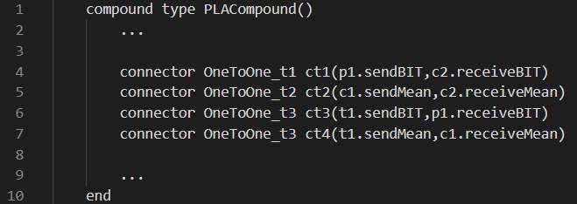
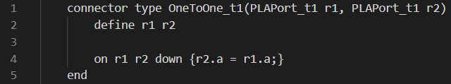
Connector Type
Connector name | Parameters
OneToOne_t1 | PLAPort_t1, PLAPort_t1
OneToOne_t2 | PLAPort_t4, PLAPort_t4
OneToOne_t3 | PLAPort_t2, PLAPort_t2
Merge | PLAPort_t2 * 3
ThreeToOne | PLAPort_t1 * 3, PLAPort_t3
Merge_two | PLAPort_t4, PLAPort_t4
TwoToOne | PLAPort_t1 * 2, PLAPort_t5
Task
Atom
BIT
Compound
Cal
Atom
ES
Compound
Task
Atom
BIT
Compound
Cal
Atom
ES
Compound
ct2
ct1
ct4
ct3
Task
Atom
BIT
Compound
Cal
Atom
ES
Compound
Task
Atom
BIT
Compound
Cal
Atom
ES
Compound

Slide 9
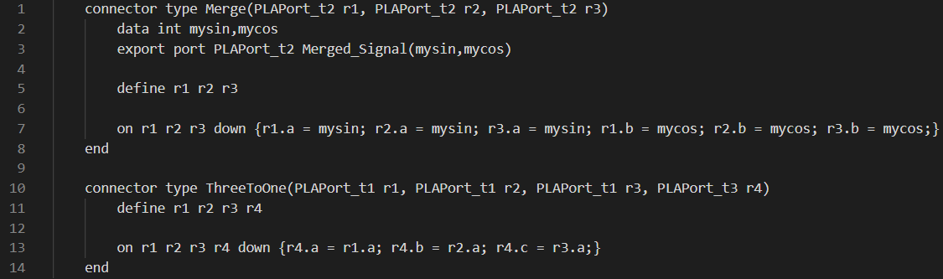
Connector Type
Connector name | Parameters
OneToOne_t1 | PLAPort_t1, PLAPort_t1
OneToOne_t2 | PLAPort_t4, PLAPort_t4
OneToOne_t3 | PLAPort_t2, PLAPort_t2
Merge | PLAPort_t2 * 3
ThreeToOne | PLAPort_t1 * 3, PLAPort_t3
Merge_two | PLAPort_t4, PLAPort_t4
TwoToOne | PLAPort_t1 * 2, PLAPort_t5
receiveBIT(PLA.sin, PLA.cos)
Diagnosis P1
Diagnosis P2
Diagnosis P3
receive
receive
receive
send
send
send
Diagnosis Decider
receiveSignal
output

Slide 10
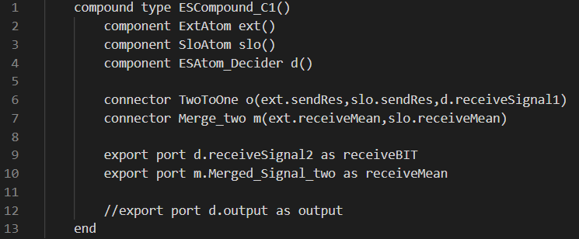
Compound Example
c2
output
Diagnosis Decider
Diagnosis P1
Diagnosis P2
receiveMean
receiveBIT
Merge_two TwoToOne receiveBIT

Slide 11
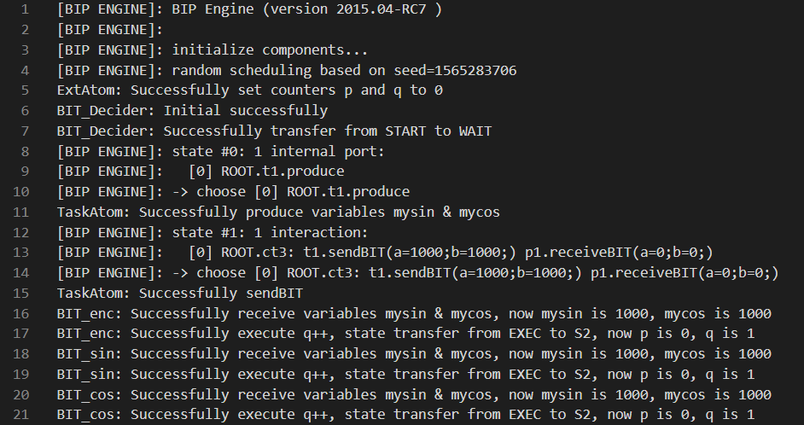
Execution Result
The intermediate output are visible by adding printf() functions to help us understand and observe the output results.
Precondition
Variables mysin(PLA.sin) and mycos(PLA.cos) is given to the system both as value 1000, same as other variables and formula.
Due to the BIP Engines’ characteristic, all the branches in the execution are chosen randomly.
Closed system

Slide 12
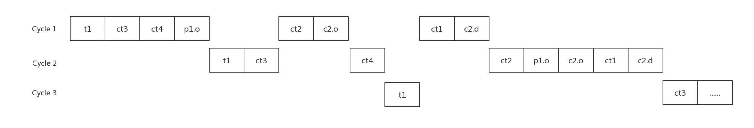

Slide 13

Tracing and Interleaving
ct4
ct3
c1
c2
t1
p1
ct2
ct1

Slide 14
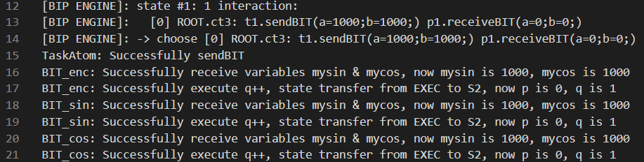
Tracing and Interleaving
ct4
ct3
c1
c2
t1
p1
ct2
ct1

Slide 15
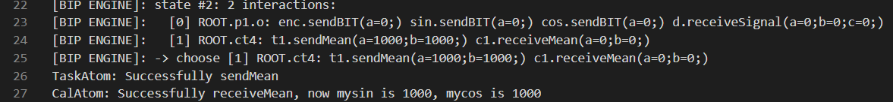
Tracing and Interleaving
ct4
ct3
c1
c2
t1
p1
ct2
ct1

Slide 16
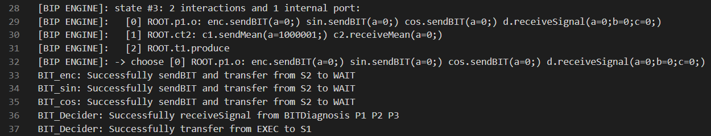
Tracing and Interleaving
ct4
ct3
c1
c2
t1
p1
ct2
ct1

Slide 17

Tracing and Interleaving
ct4
ct3
c1
c2
t1
p1
ct2
ct1

Slide 18
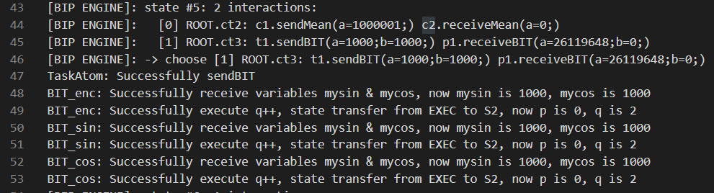
Tracing and Interleaving
ct4
ct3
c1
c2
t1
p1
ct2
ct1

Slide 19
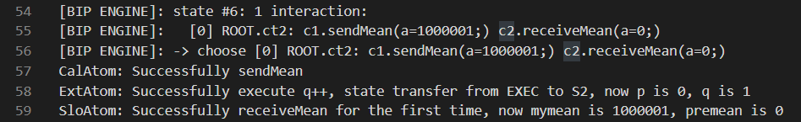
Tracing and Interleaving
ct4
ct3
c1
c2
t1
p1
ct2
ct1

Slide 20
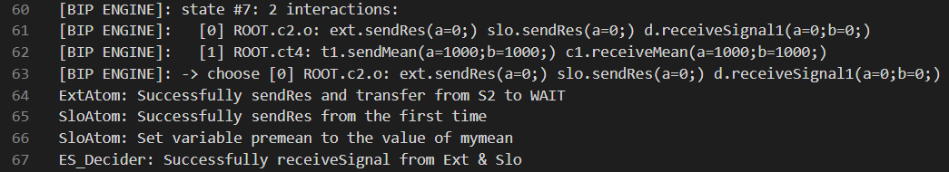
Tracing and Interleaving
ct4
ct3
c1
c2
t1
p1
ct2
ct1

Slide 21
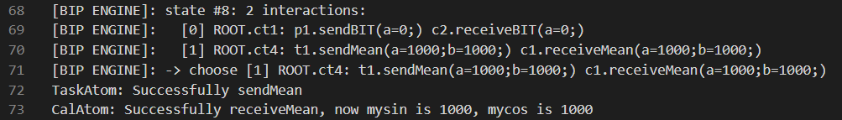
Tracing and Interleaving
ct4
ct3
c1
c2
t1
p1
ct2
ct1

Slide 22
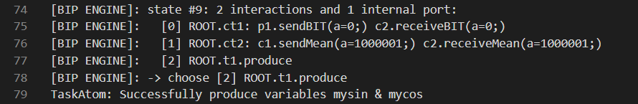
Tracing and Interleaving
ct4
ct3
c1
c2
t1
p1
ct2
ct1

Slide 23
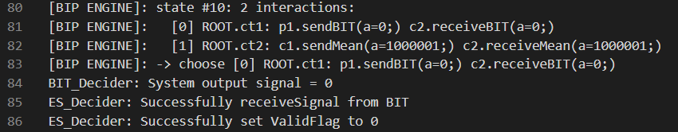
Tracing and Interleaving
ct4
ct3
c1
c2
t1
p1
ct2
ct1

Slide 24
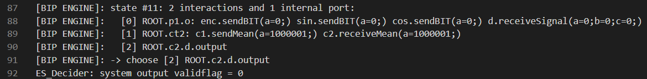
Tracing and Interleaving
ct4
ct3
c1
c2
t1
p1
ct2
ct1

Slide 25
Sensor Data —— Task
Wait
produce(PLA.sin, PLA.cos)
Start
Task
sendMean
sendBIT
The Task in Sensor Data implements a message sender which provides a PLA.sin & PLA.cos signal for Data processing unit every cycle.
sendBIT(PLA.sin, PLA.cos)
produce(PLA.sin, PLA.cos)
Send
Sensor Data
sendMean(PLA.sin, PLA.cos)
End

Slide 26
Compound automaton —— BIT Diagnosis
receiveBIT(PLA.sin, PLA.cos)
Diagnosis P1
Diagnosis P2
Diagnosis P3
receive
receive
receive
BIT Diagnosis
Calibration Conversion
Extremum/Slop Diagnosis
send
send
send
Diagnosis Decider
receiveSignal
Data Processing Unit
output
BIT Diagnosis
As the first part of PLA signal processing, BIT Diagnosis consists of five parts: A diagnosis control module, three diagnosis parts and a diagnosis decider. A diagnosis control module is designed to control the other parts of system, it gives a “ready” signal with a certain delay after power on. The three diagnosis parts works in parallel to detect whether the two input signals “PLA.sin” and “PLA.cos” are valid or not, the results will be sent to the diagnosis decider, a total fault flag will be set “true” as long as one of the diagnosis part returns a fault flag of “true” value, otherwise this fault flag will be “false” indicating that the current signals is valid after BIT Diagnosis.
Notes:
TODO：分颜色画线

Slide 27
BIT Diagnosis —— Diagnosis P1
START
receiveBIT(PLA.sin, PLA.cos)
Variable | Name | Input/Output
PLA.sin | sin value of Throttle stick angle | Input
PLA.cos | cos value of Throttle stick angle | Input
PLA.Singal_enc | PLA excitation disconnection fault sign | Output
Diagnosis P1
Diagnosis P2
Diagnosis P3
Diagnosis Decider
p:=0; q:=0
output
BIT Diagnosis
WAIT
sendBIT(PLA.Signal_enc)
⑥
receiveBIT(PLA.sin, PLA.cos)
③
⑦
Transition | Guard | Action
1 | PLA.sin<500 ∧ PLA.cos<500 | p:=p+1; q:=0
2 | PLA.sin>=500 ∧ PLA.cos>=500 | p:=0; q:=q+1
3 | PLA.sin>=500 ⊕ PLA.cos>=500 | p:=0; q:=0
4 | p>=5 | PLA.Signal_enc:=1
5 | q>=5 | PLA.Signal_enc:=0
6 | [p<5] | null
7 | [q<5] | null
EXEC
①
②
S1
S2
④
⑤
END

Slide 28
BIT Diagnosis —— Diagnosis P2
START
receiveBIT(PLA.sin, PLA.cos)
Variable | Name | Input/Output
PLA.sin | sin value of Throttle stick angle | Input
PLA.cos | cos value of Throttle stick angle | Input
PLA.Singal_sin | sin signal disconnection fault sign | Output
Diagnosis P1
Diagnosis P2
Diagnosis P3
Diagnosis Decider
p:=0; q:=0
output
BIT Diagnosis
WAIT
sendBIT(PLA.Signal_sin)
⑥
receiveBIT(PLA.sin, PLA.cos)
③
⑦
Transition | Guard | Action
1 | PLA.sin>4000 | p:=p+1; q:=0
2 | PLA.sin>=500 ∧ PLA.sin<=4000 | p:=0; q:=q+1
3 | PLA.sin<500 | p:=0; q:=0
4 | p>=5 | PLA.Signal_sin:=1
5 | q>=5 | PLA.Signal_sin:=0
6 | [p<5] | null
7 | [q<5] | null
EXEC
①
②
S1
S2
④
⑤
END

Slide 29
BIT Diagnosis —— Diagnosis P3
START
receiveBIT(PLA.sin, PLA.cos)
Variable | Name | Input/Output
PLA.sin | sin value of Throttle stick angle | Input
PLA.cos | cos value of Throttle stick angle | Input
PLA.Singal_cos | cos signal disconnection fault sign | Output
Diagnosis P1
Diagnosis P2
Diagnosis P3
Diagnosis Decider
p:=0; q:=0
output
BIT Diagnosis
WAIT
sendBIT(PLA.Signal_cos)
⑥
receiveBIT(PLA.sin, PLA.cos)
③
⑦
Transition | Guard | Action
1 | PLA.cos>4000 | p:=p+1; q:=0
2 | PLA.cos>=500 ∧ PLA.cos<=4000 | p:=0; q:=q+1
3 | PLA.cos<500 | p:=0; q:=0
4 | p>=5 | PLA.Signal_cos:=1
5 | q>=5 | PLA.Signal_cos:=0
6 | [p<5] | null
7 | [q<5] | null
EXEC
①
②
S1
S2
④
⑤
END

Slide 30
BIT Diagnosis —— Diagnosis Decider
receiveBIT(PLA.sin, PLA.cos)
Diagnosis P1
Diagnosis P2
Diagnosis P3
Variable | Name | Input/Output
PLA.Signal | PLA signal BIT fault flag | Output
PLA.Signal_enc | PLA Incentive disconnection fault flag | Input
PLA.Singal_sin | sin signal disconnection fault flag | Input
PLA.Signal_cos | cos signal disconnection fault flag | Input
START
Diagnosis Decider
output
BIT Diagnosis
WAIT
output(PLA.Signal)
receiveSignal(PLA.Signal_enc, PLA.Signal_sin, PLA.Signal_cos)
EXEC
output(PLA.Signal)
Transition | Guard | Action
1 | PLA.Signal_enc=0 ∧ PLA.Signal_sin=0 ∧ PLA.Signal_cos=0 | PLA.Signal:=0
2 | PLA.Signal_enc=1∨ PLA.Signal_sin=1∨ PLA.Signal_cos=1 | PLA.Signal:=1
①
②
S1
S2

Slide 31
BIT Diagnosis —— Diagnosis Decider
receiveSignal
START
WAIT
output(PLA.Signal)
receiveSignal(PLA.Signal_enc, PLA.Signal_sin, PLA.Signal_cos)
EXEC
output(PLA.Signal)
①
②
S1
S2
output

Slide 32
BIT Diagnosis —— Diagnosis Decider
Transition | Guard | Action
1 | PLA.Signal_enc=0 ∧ PLA.Signal_sin=0 ∧ PLA.Signal_cos=0 | PLA.Signal:=0
2 | PLA.Signal_enc=1∨ PLA.Signal_sin=1∨ PLA.Signal_cos=1 | PLA.Signal:=1

Slide 33
Component automaton —— Calibration conversion
Variable | Name | Input/Output
PLA.sin | sin value of Throttle stick angle | Input
PLA.cos | cos value of Throttle stick angle | Input
PLA_Original | PLA Original value collected | /
PLA.CLB | PLA physical qunatity | Output
Start
sendMean(PLA.CLB)
receiveBIT(PLA.sin, PLA.cos)
Exec
*The calibration curve remains to be decided
PLA.Original $=f(PLA.sin,PLA.cos)$
PLA.CLB $=g(PLA.Original)$
End
Calibration is a concept often used in scientific research. In this part, system converts the two signal “PLA.sin” and “PLA.cos” into its original value “PLA.Original”.
Then a calibration curve converts “PLA.Original” signal into physical quantity PLA.CLB, the unit is °
Notes:
两个方程需要用c语言表达

Slide 34
Compound automaton —— Extremum/Slope Diagnosis
receiveBIT(PLA.Signal)
receiveMean(PLA.Signal_MeanData)
Extremum and Slope Diagnosis is almost the same struct as BIT Diagnosis except that it uses the output of BIT Diagnosis as its input.
In other words, in this system, the decider integrates the output of BIT Diagnosis and the result signals of this component into one output which gives a judgment whether the signal collected is valid or not.
Diagnosis P1 is an extremum diagnosis and Diagnosis P2 is a slope diagnosis.
*In Slope Diagnosis, data in previous cycle will be considered to calculate the slope.
Diagnosis P1
Diagnosis P2
sendRes
sendRes
Diagnosis Decider
receiveSignal1
receiveSignal2
output
Extremum/Slope Diagnosis

Slide 35
Extremum/Slope Diagnosis —— Diagnosis P1
Variable | Name | Input/Output
PLA.Signal_MeanData | Converted PLA signal value | Input
PLA.Signal_MinLimit | PLA signal minimum threshold | /
PLA.Signal_MaxLimit | PLA signal maximum threshold | /
PLA.Signal_Ext | PLA signal extreme value fault flag | Output
START
p:=0; q:=0
WAIT
sendRes(PLA.Signal_Ext)
Transition | Guard | Action
1 | PLA.Signal_MeanData>PLA.Signal.MaxLimit ∨ PLA.Signal_MeanData<PLA.Signal_MinLimit | p:=p+1; q:=0
2 | PLA.Signal_MeanData>=PLA.Signal_MinLimit ∧ PLA.Signal_MeanData<=PLA.Signal_MaxLimit | p:=0; q:=q+1
3 | p>=5 | PLA.Signal_Ext:=1
4 | q>=5 | PLA.Signal_Ext:=0
5 | [p<5] | null
6 | [q<5] | null
⑤
receiveMean(PLA.Signal_MeanData)
⑥
EXEC
①
②
S1
S2
③
④
END
*N remains to be decided

Slide 36
Extremum/Slope Diagnosis —— Diagnosis P2
START
Variable | Name | Input/Output
PLA.Signal_MeanData | Converted PLA signal value | Input
PLA.MeanData_Pre | Converted PLA signal value in previous cycle | Input
PLA.Signal_SlopeLimit | PLA signal slope threshold | /
PLA.Signal_Slo | PLA signal slope fault flag | Output
p:=0; q:=0
WAIT
receiveMean(PLA.Signal_MeanData)
WAIT1
sendRes(PLA.Signal_Slo)
Transition | Guard | Action
1 | |PLA.Signal_MeanData-PLA.MeanData_Pre| >PLA.Signal.SlopeLimit | p:=p+1; q:=0
2 | |PLA.Signal_MeanData-PLA.MeanData_Pre| <PLA.Signal.SlopeLimit | p:=0; q:=q+1
3 | p>=5 | PLA.Signal_Slo:=1
4 | q>=5 | PLA.Signal_Slo:=0
5 | [p<5] | null
6 | [q<5] | null
PLA.MeanData_Pre:=PLA.Signal_MeanData
WAIT2
⑤
⑥
receiveMean(PLA.Signal_MeanData)
①
EXEC
②
Assign current MeanData value to previous MeanData variable PLA.MeanData_Pre for calculating
S1
S2
③
④
END

Slide 37
Extremum/Slope Diagnosis —— Diagnosis Decider
Variable | Name | Input/Output
PLA.Signal | PLA signal BIT fault flag | Input
PLA.Signal_Ext | PLA signal extreme value fault flag | Input
PLA.Signal_Slo | PLA signal slope failure flag | Input
PLA.ValidFlag | PLA signal failure sign | Output
START
WAIT
receiveSignal1(PLA.Signal_Ext, PLA.SignalSlo)
WAIT1
receiveSignal2(PLA.Signal)
Transition | Guard | Action
1 | [PLA.Signal=0∧PLA.Signal_Ext=0 ∧ PLA.Signal_Slo=0] | PLA.ValidFlag:=0
2 | [PLA.Signal=1∨PLA.Signal_Ext=1 ∨ PLA.Signal_Slo=1] | PLA.ValidFlag:=1
output(PLA.ValidFlag)
EXEC
output(PLA.ValidFlag)
①
②
S1
S2
Notes:
TODO：合并receive

Slide 38

Sensor Data —— Task
Wait
Task
sendMean
sendBIT
The Task in Sensor Data implements a message sender which provides a PLA.sin & PLA.cos signal for Data processing unit every cycle.
produce(PLA.sin, PLA.cos)
produce(PLA.sin, PLA.cos)
Start
Sensor Data
sendBIT(PLA.sin, PLA.cos)
Send
sendMean(PLA.sin, PLA.cos)
In this case, we instance a TaskAtom as t1.
After we run the BIP executable system, t1 will output a line of success information as soon as the two variables are produced.
End

Slide 39
Architecture model
PLA.sin := TPLA.sin; PLA.cos := TPLA.cos
PLA.sin := TPLA.sin; PLA.cos := TPLA.cos
ct4
ct3
Task
receiveBIT(PLA.sin, PLA.cos)
receiveMean(PLA.sin,
PLA.cos)
sendRes
sendMean
sendBIT
c2
Diagnosis P1
Diagnosis P2
Diagnosis P3
Diagnosis Decider
c1
Diagnosis P1
Diagnosis P2
Diagnosis Decider
t1
p1
sendBIT(PLA.Signal)
sendMean(PLA.CLB)
receiveMean
receiveBIT
produce(PLA.sin, PLA.cos)
ct2
BIT Diagnosis
ct1
Calibration Conversion
Extremum/Slope Diagnosis
Sensor Data
Data Processing Unit
We instance a BITCompound as p1, a CalAtom as c1 and an ESCompound as c2
We also define 4 interactions ct1, ct2, ct3, ct4.
Notes:
As a representation of the environment, compound component “sensor data” provides the input periodically. The component “Task” generates the four inputs, while the component “Cyclic trigger” gives the ‘start’ signal to send the inputs to data processing unit.
The compound automaton BIT Diagnosis receives two signal “PLA.sin” and “PLA.cos” and gives a valid/invalid signal of its input.
The component automaton Mean Data Calculation is used to convert the collected physical quantity to its original value.
The compound automaton Extremum/Slope Diagnosis integrates the signals and gives an overall judgment whether the input signal of system is valid or not.
//The component automaton Compensation & Filtering is used to give a standard output of collected data

